Slide 1
Introduction to Database Systems
NoSQL & JSON
(mostly not in textbook… only Ch 11.1)
1

Slide 2
NoSQL Motivation
Originally motivated by Web 2.0 applications
Goal is to scale simple OLTP-style workloads to millions or billions of users
Ex: Facebook has 1.2B daily active users
use often correlated in time in each region
> 10M req/sec if 25% of users arrive within one hour
SQL Server would collapse under that workload
Users are doing both updates and reads
2

Slide 3
What is the Problem?
Single server DBMS are too small for Web data
Solution: scale out to multiple servers
This is hard for the entire functionality of DBMS
as we will see next…
NoSQL: reduce functionality for easier scaling
Simpler data model
Fewer guarantees
3

Slide 4










Serverless Architecture
Desktop
User
SQLite:
One data file
One user
One DBMS application
DBMS
Application (SQLite)
Scales well!
But only a limited number of scenarios work with such model
(Can be in browser / phone!)
File
Data file
Disk
6

Slide 5











Client-Server Architecture
Supports many apps and
many users simultaneously
Client Applications
Server Machine
File 1
File 2
File 3
DB Server
Connection (JDBC, ODBC)
One server running the database
Many clients, connecting via the ODBC or JDBC (Java Database Connectivity) protocol
5

Slide 6
Client-Server
One server that runs the DBMS (or RDBMS):
Your own desktop, or
Some beefy system, or
A cloud service (SQL Azure)
Many clients run apps and connect to DBMS
Microsoft’s Management Studio (for SQL Server), or
psql (for postgres)
Some Java program (HW8) or some C++ program
Clients “talk” to server using JDBC/ODBC protocol
6

Slide 7









3-Tiered Architecture
Browser
File 1
File 2
File 3
DB Server
7

Slide 8







3-Tiered Architecture
Browser
File 1
File 2
File 3
DB Server
Connection
(e.g., JDBC)
HTTP/SSL
App+Web Server
Web-based applications
8

Slide 9








Replicate App server for scale up
3-Tiered Architecture
App+Web Server
File 1
Connection
App+Web Server
File 2
(e.g., JDBC)
HTTP/SSL
File 3
DB Server
App+Web Server
Why don’t we replicate the DB server too?
11

Slide 10
Replicating the Database
Much harder because the state must be unique. In other words, the database must act as a whole
Current DB instance must always be consistent
Ex: foreign keys must exist
as a result, some updates must occur simultaneously
Two basic approaches:
Scale up through partitioning
Scale up through replication
10

Slide 11
Scale Through Partitioning
Partition the database across many machines in a cluster
Database could fit in main memory
Queries spread across these machines
Can increase throughput
Easy for (simple) writes but reads become harder
Transaction starts here
Also touches data here
Three partitions
11

Slide 12
Scale Through Replication
Create multiple copies of each database partition
Spread queries across these replicas
Can increase throughput and lower latency
Can also improve fault-tolerance
Easy for reads but writes become harder
Some requests
Other requests
Three replicas

Slide 13
NoSQL Data Models
Taxonomy based on data models:
☞ • Key-value stores
– e.g., Project Voldemort, Memcached
Document stores
e.g., SimpleDB, CouchDB, MongoDB
Extensible Record Stores
e.g., HBase, Cassandra, PNUTS

Slide 14
Key-Value Stores Features
Data model: (key, value) pairs
Key = string/integer, unique for the entire data
Value = can be anything (very complex object)
Operations
Get(key), Put(key, value)
Operations on value not supported
Distribution / Partitioning
No replication: key k is stored at server h(k)
3-way replication: key k is stored at h1(k), h2(k), h3(k)
How does get(k) work? How does put(k, v) work?

Slide 15
Example
Flights(fid, date, carrier, flight_num, origin, dest, ...) Carriers(cid, name)
How would you represent the Flights data as (key, value) pairs?
Option 1: key=fid, value=entire flight record
Option 2: key=date, value=all flights that day
Option 3: key=(origin, dest), value=all flights between How does query processing work?

Slide 16
Key-Value Stores Internals
Data remains in main memory
one implementation: distributed hash table
Most systems also offer a persistence option
Others use replication to provide fault-tolerance
Asynchronous or synchronous replication
Tunable consistency: read/write one replica or majority
Some offer transactions, others do not
multi-version concurrency control or locking
No secondary indices

Slide 17
Data Models
Taxonomy based on data models:
Key-value stores
e.g., Project Voldemort, Memcached
☞ • Document stores
e.g., SimpleDB, CouchDB, MongoDB
Extensible Record Stores
e.g., HBase, Cassandra, PNUTS

Slide 18
Document Stores Features
Data model: (key, document) pairs
Key = string/integer, unique for the entire data
Document = JSON or XML
Operations
Get/put document by key
Limited, non-standard query language on JSON
Distribution / Partitioning
Entire documents, as for key/value pairs
We will discuss JSon today or tomorrow

Slide 19
Data Models
Taxonomy based on data models:
Key-value stores
e.g., Project Voldemort, Memcached
Document stores
e.g., SimpleDB, CouchDB, MongoDB
☞ • Extensible Record Stores
e.g., HBase, Cassandra, PNUTS

Slide 20
Extensible Record Stores
Based on Google’s BigTable
HBase is an open source implementation of BigTable
Data model is rows and columns
can add both new rows and new columns
Scalability by splitting rows and columns over nodes
Rows partitioned through hashing on primary key
Columns of a table are distributed over multiple nodes by using “column groups”

Slide 21
NoSQL Summary
Simpler data model with weaker guarantees
But they scale as far as we need them to
Meanwhile…
SQL systems continue to improve

Slide 22
Recent SQL Progress
Modern systems need to store data across the globe
individual data centers go offline
need servers close to users to be efficient
Speed of light is a fundamental limit
200+ms latency (across US) is visible to users
Systems must weaken guarantees
Google’s Spanner (supports SQL):
write data over the whole globe (a bit slowly)
reads occur slightly in the past

Slide 23
Prediction
My guess: SQL will win again
Pieces are out there already
Spanner: multi-node transactions
AsterixDB: multi-node query optimization
For now, NoSQL still offers key benefits

Slide 24
JSon and Semi-structured Data

Slide 25
Where We Are
So far we have studied the relational data model
Data is stored in tables (relations)
Queries are expressions in the SQL / Datalog / relational algebra
Today: Semi-structured data model
Popular formats today: XML, JSon, protobuf

Slide 26
JSON
10 years ago…
JavaScript interpreters were very slow
native browser function parsed JSON 100x faster
XML was also an option, but
IE had a memory leak in its XML parser
JSON used in Gmail etc. for this reason
Spread organically to server-side systems

Slide 27
JSON - Overview
JavaScript Object Notation = lightweight text- based open standard designed for human- readable data interchange. Interfaces in C, C++, Java, Python, Perl, etc.
The filename extension is .json.
We will emphasize JSon as semi-structured data

Slide 28
JSon vs. Relational
Relational data model
Rigid flat structure (tables)
Schema must be fixed in advanced
Binary representation: good for performance, bad for exchange
Query language based on Relational Calculus
Semi-structured data model / JSon
Flexible, nested structure (trees)
Does not require predefined schema ("self describing”)
Text representation: good for exchange, bad for performance
Most common use: Language API; query languages emerging

Slide 29
JSon Syntax
{ "book": [
{"id": “01",
"language": "Java”,
"author": ”H. Javeson”, “year”: 2015
},
{"id": "07",
"language": "C++", "edition": "second" "author": "E. Sepp”, “price”: 22.25
}
]
}

Slide 30
JSon Terminology
Curly braces hold objects
Each object is a list of name/value pairs separated by , (comma)
Each pair is a name is followed by ':’ (colon) followed by the value
Square brackets hold arrays and values are separated by , (comma).
Data made up of objects, lists, and atomic values (integers, floats, strings, booleans).

Slide 31
JSon Data Structures
Collections of name-value pairs:
{“name1”: value1, “name2”: value2, …}
The “name” is also called a “key”
Ordered lists of values:
– [obj1, obj2, obj3, ...]

Slide 32
Avoid Using Duplicate Keys
The standard allows them, but many implementations don’t
{"id":"07",
”title": “Databases”, "author": “Garcia-Molina”, "author": “Ullman”,
"author": “Widom”
}
{"id":"07",
"title": “Databases”, "author": [“Garcia-Molina”,
“Ullman”,
“Widom”]
}

Slide 33
JSon Data Types
Number
String = double-quoted
Boolean = true or false
null / empty

Slide 34
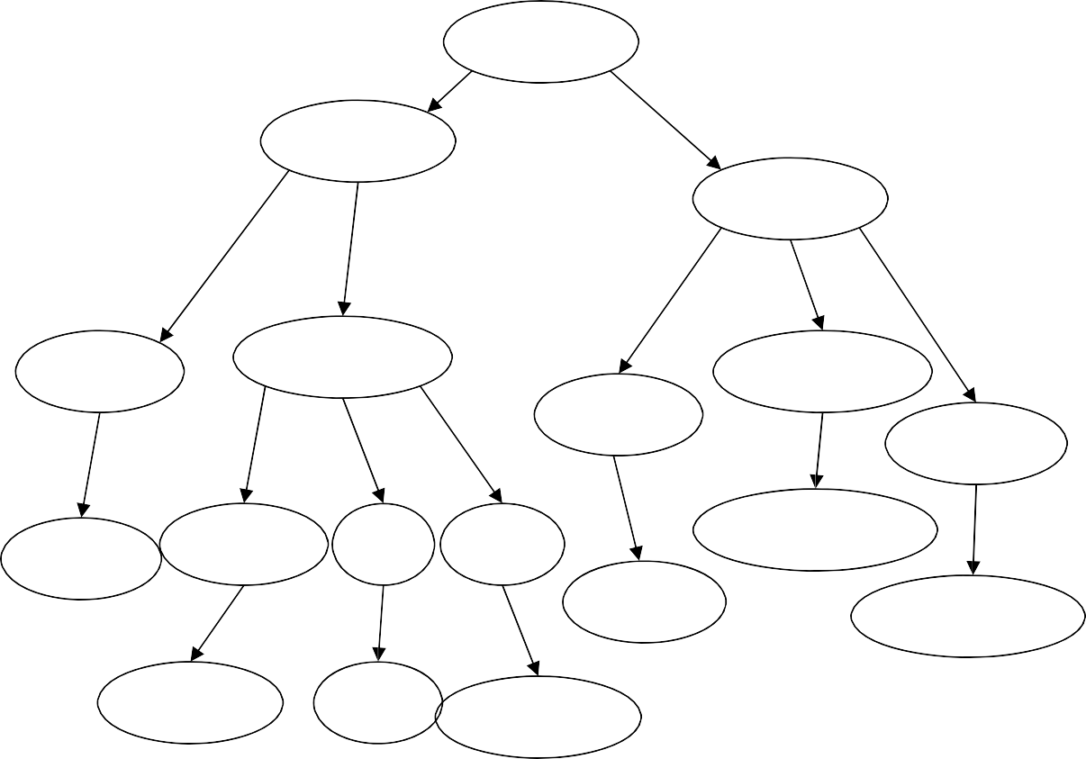
JSon Semantics: a Tree !
person
{“person”:
[ {“name”: “Mary”, “address”:
{“street”: “Maple”, “no”: 345,
“city”: “Seattle”}},
{“name”: “John”, “address”: “Thailand”, “phone”: 2345678}
]
}
name
address
address
name
phone
Mary
street
no
city
Thailand
John
2345678
Maple
345
Seattle
36

Slide 35
JSon Data
JSon is self-describing
Schema elements become part of the data
Relational schema: person(name, phone)
In Json “person”, “name”, “phone” are part of the data, and are repeated many times
Consequence: JSon is much more flexible
also uses more space (but can be compressed)
JSon is an example of semi-structured data
37

Slide 36
Mapping Relational Data to JSON
person
Person
name “John”
phone name 3634 “Sue”
phone name 6343 “Dirk”
phone 6363
name | phone
John | 3634
Sue | 6343
Dirk | 6363
{“person”:
[{“name”: “John”, “phone”: 3634},
{“name”: “Sue”, “phone”: 6343},
{“name”: “Dirk”, “phone”: 6383}
]
}

Slide 37
Mapping Relational Data to JSON
May inline foreign keys Person
{“Person”:
[{“name”: “John”, “phone”: 3646,
“Orders”: [{“date”: 2002,
“product”: “Gizmo”},
{“date”: 2004,
“product”: “Gadget”}
]
},
{“name”: “Sue”, “phone”: 6343,
“Orders”: [{“date”: 2002,
“product”: “Gadget”}
]
}
]
}
name | phone
John | 3634
Sue | 6343
Orders
personName | date | product
John | 2002 | Gizmo
John | 2004 | Gadget
Sue | 2002 | Gadget

Slide 38

JSON = Semi-structured Data (1/3)
Missing attributes:
{“person”:
[{“name”: “John”, “phone”: 1234},
{“name”: “Joe”}]
}
no phone !
Could represent a table with nulls
name | phone
John | 1234
Joe | -

Slide 39


JSON = Semi-structured Data (2/3)
Repeated attributes
{“person”:
[{“name”: “John”, “phone”: 1234},
{“name”: “Mary”, “phone”: [1234, 5678]}]
}
Two phones !
Impossible in one table:
name | phone
Mary | 2345 | 3456
???

Slide 40



JSON = Semi-structured Data (3/3)
Attributes with different types in different objects
{“person”:
[{“name”: “Sue”, “phone”: 3456},
{“name”: {“first”: “John”, “last”: “Smith”}, “phone”: 2345}
]
}
Structured name !
Nested collections
Heterogeneous collections

Slide 41
Discussion
Data exchange formats
well suited for exchanging data between apps
XML, JSON, Protobuf
Increasingly, some systems use them as a data model:
SQL Server: supports for XML-valued relations
CouchBase, Mongodb: JSON as data model
Dremel (BigQuery): Protobuf as data model

Slide 42
Query Languages for Semi-Structured Data
XML: XPath, XQuery (see end of lecture, textbook)
Supported inside many RDBMS (SQL Server, DB2, Oracle)
Several standalone XPath/XQuery engines
Protobuf: used internally by Google, and externally in BigQuery. similar to compiled JSON
JSON:
CouchBase: N1QL
MongoDB: has a pattern-based language
JSONiq http://www.jsoniq.org/
AsterixDB: AQL and SQL++

